Slide 1
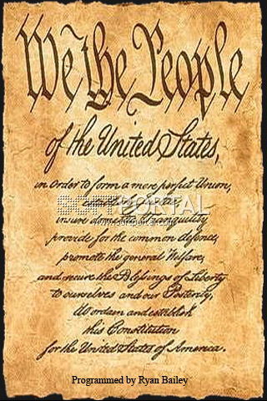
The US Government
The US Constitution

Slide 2
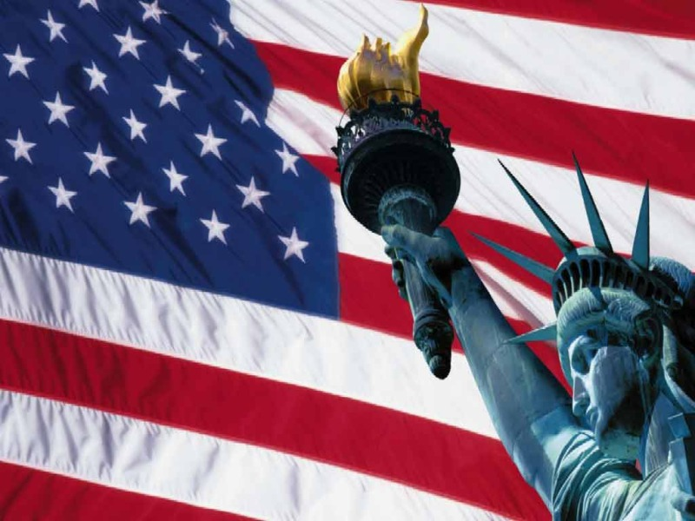
Who Rules the Country?

Slide 3
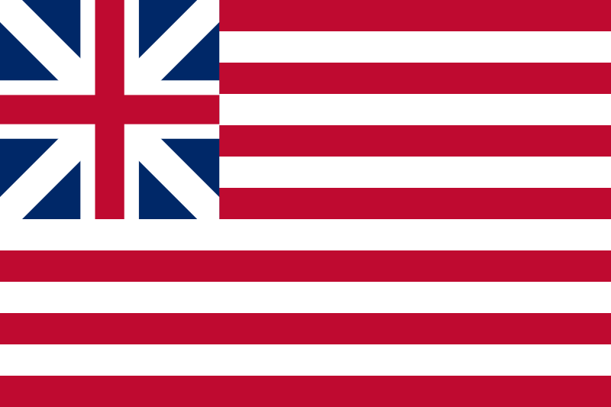
The “Continental flag”
This flag symbolizes the colony of Great Britain.

Slide 4
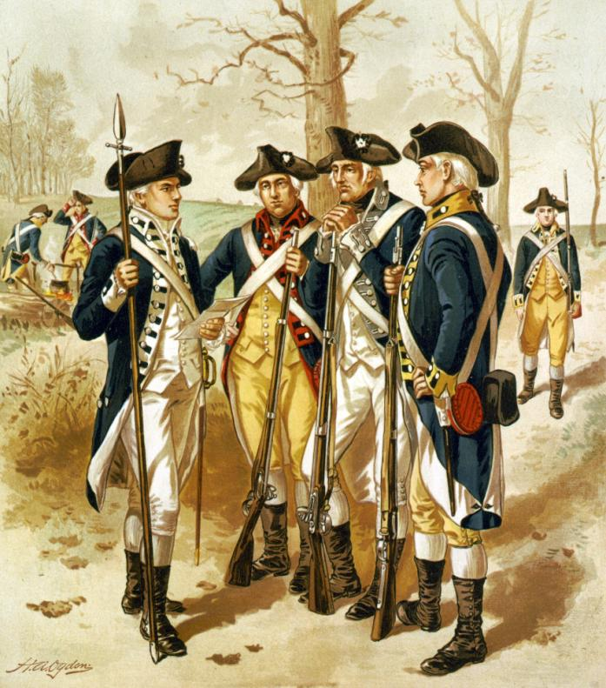
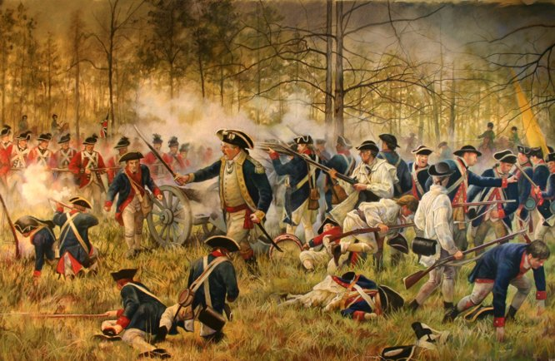
The Revolutionary War (the War of Independence)
(1775 -1783)
The colonies declared a war on Great Britain because they wanted to be independent.

Slide 5
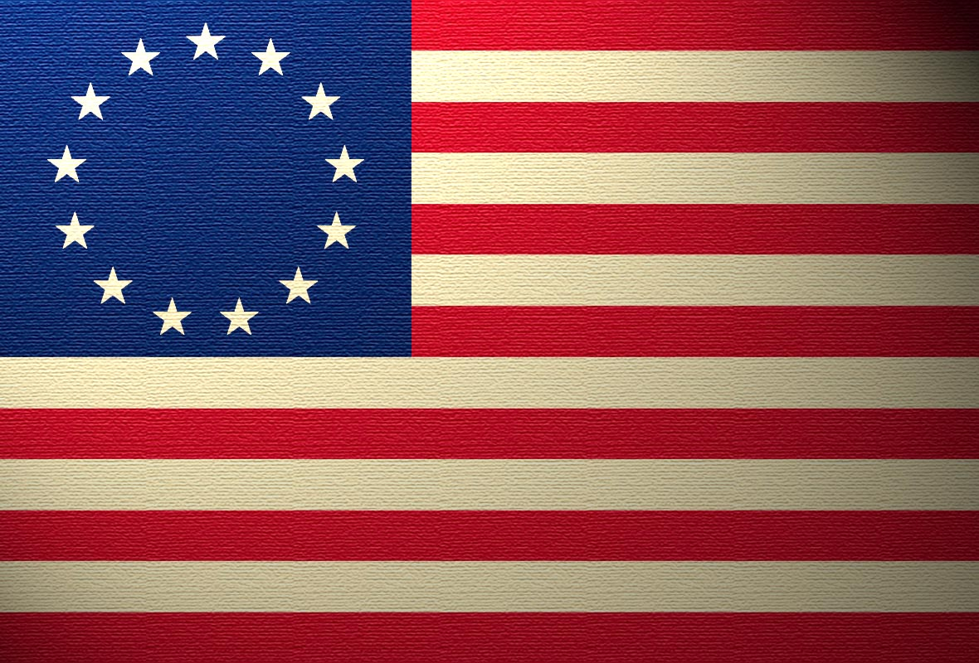
The first official flag of the USA.

Slide 6
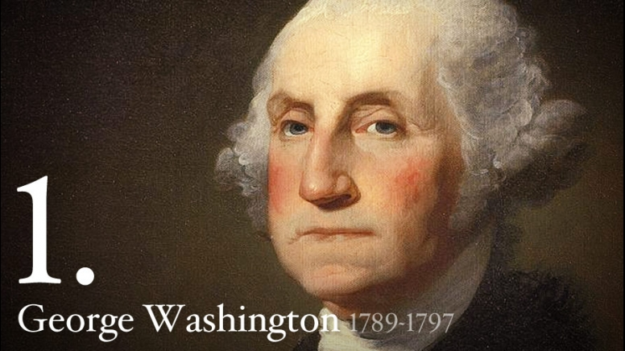
Was Commander in chief of the Colonial Army
during the Revolutionary War.

Slide 7
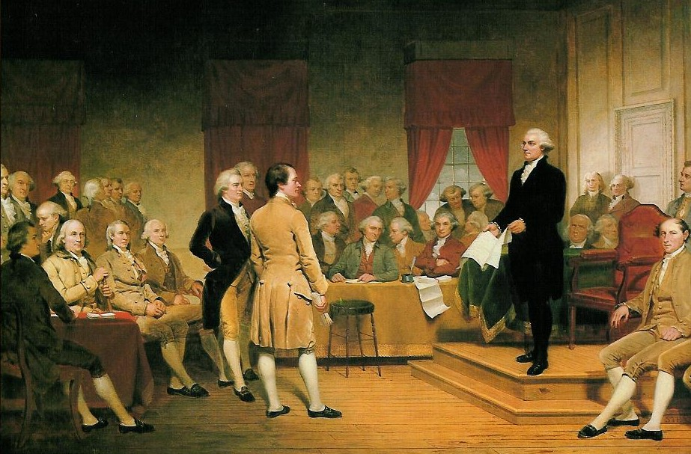
Philadelphia 1787
All the states sent their representatives to Philadelphia
where they wrote the Constitution.

Slide 8
The US Constitution was written more than 220 years ago and it is still working!
There are 26 amendments to the Constitution.
The first 10 amendments are called the Bill of Rights.

Slide 9
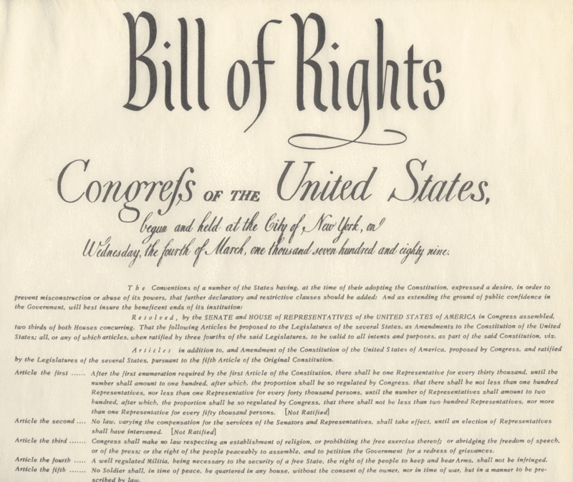

Slide 10
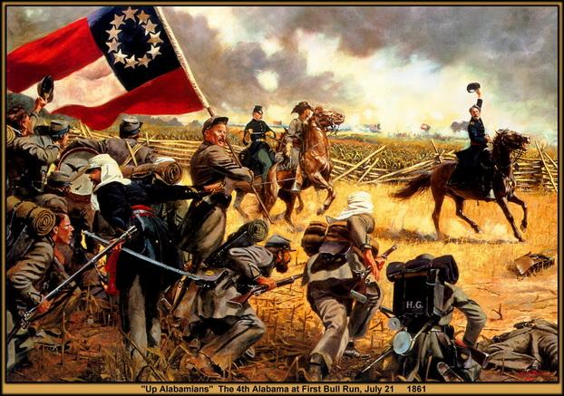
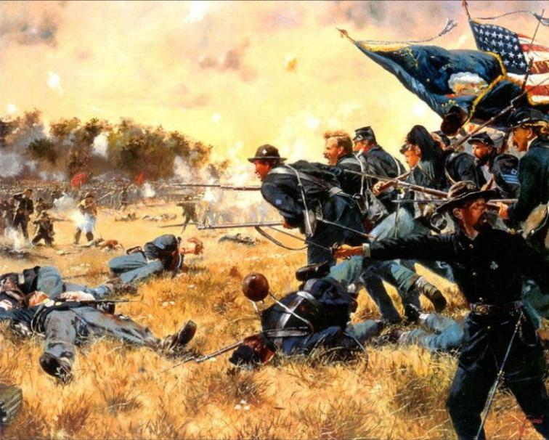
The Civil War(1861 – 1865)
(The War between states)
One of the issues of the war was freeing of the slaves.

Slide 11
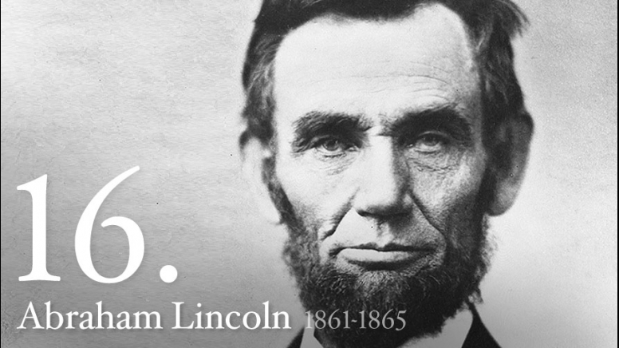
Had to lead the country through the four terrible years
of the Civil War.

Slide 12
With the emancipation of the slaves, new issues, such as civil rights, appeared.
The 13th amendment ended slavery.
The 14th amendment made all black people citizens of the USA.
The 15th amendment gave black people
the right to vote.

Slide 13
1920 – the 19th amendment gave women
the right to vote
In 1971 – the 26 amendment
gave people 18 years old and older the right to vote

Slide 14
The US Government
The Congress
The President and his helpers
The Supreme Court
People

Slide 15
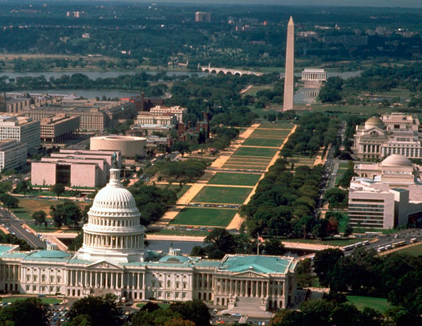
The Congress
The Senate
The House of Representatives
Meets in the US Capitol in Washington, D.C.

Slide 16
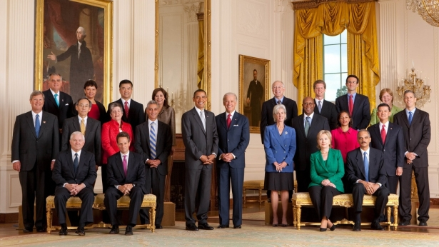
The President and his helpers
They carry out the laws that the Congress makes.

Slide 17
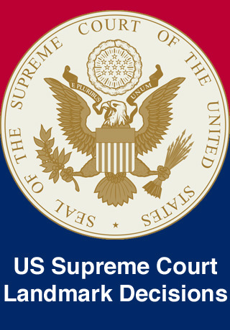
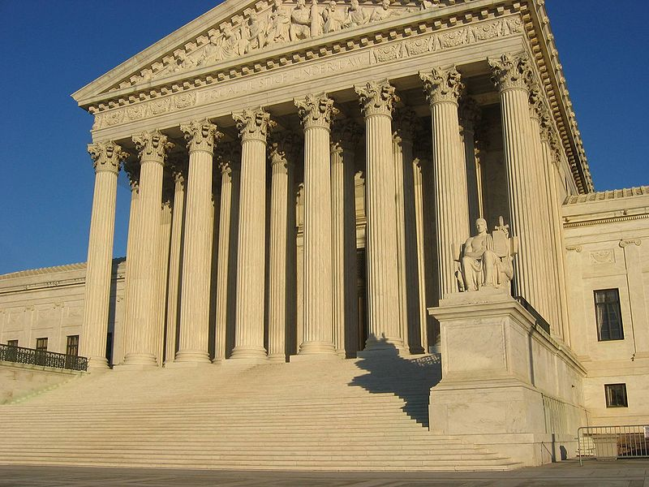
The Supreme Court

Slide 18
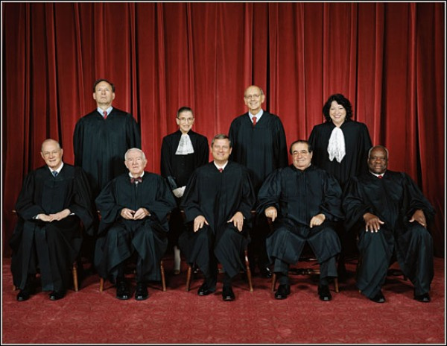
The Supreme Court is made up of nine judges.

Slide 19
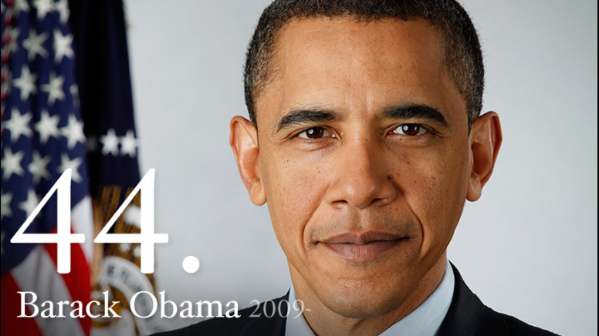
Barack Obama is the 44th president of the USA.
Barack Obama is the 44th president of the USA.

Slide 20
Questions.
When did the War of Independence begin?
In 1775.
On what country did the colonies in America declare a war?
On Great Britain.
Where was the US Constitution written?
In Philadelphia.
Who wrote the Constitution?
The representatives from all the states.
What branches of the US government can you name?
The Congress,
The President and his helpers,
The Supreme Court.
Where does the US Congress meet?
In the US Capitol.
How many judges does the Supreme Court consist of?
9 judges.
Can the US Constitution be change?
Yes, it can be changed
How many amendments are there to the Constitution?
26 amendments.

